Slide 1





#4 SPRINT REVIEW
C++ and GitHub
Avinash Pauskar
R&D Intern @ Esko

Slide 2



AGENDA
PROJECT INTRODUCTION
PROJECT DEMO
FLOWCHART & SYSTEM ARCHITECTURE
UNIQUE FEATURES
CHALLENGES & LIMITATIONS

Slide 3

GLOBAL TIME ZONE APPLICATION
Command-line utility for accessing real-time global time zone data
Key Features -
Display current time in any global time zone
Convert times between different time zones
Search time zones by region or country
Save and manage favorite time zones
Core advantage: Uses external API data instead of system clock

Slide 4
LET’S HAVE A DEMO!

Slide 5
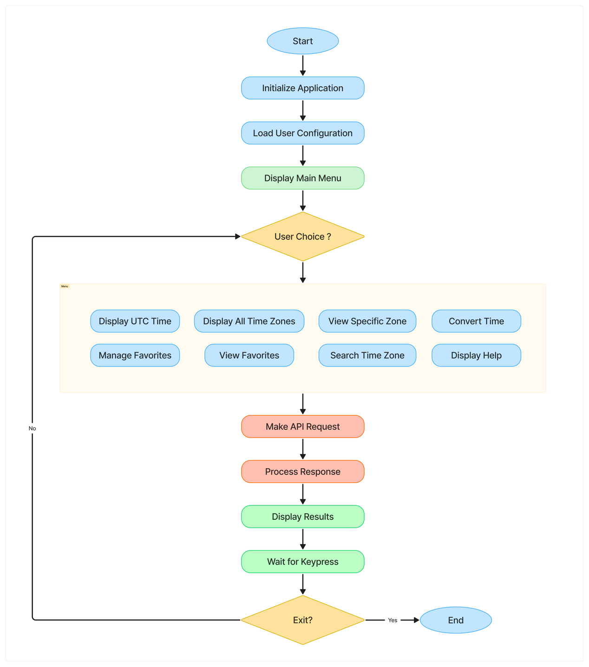
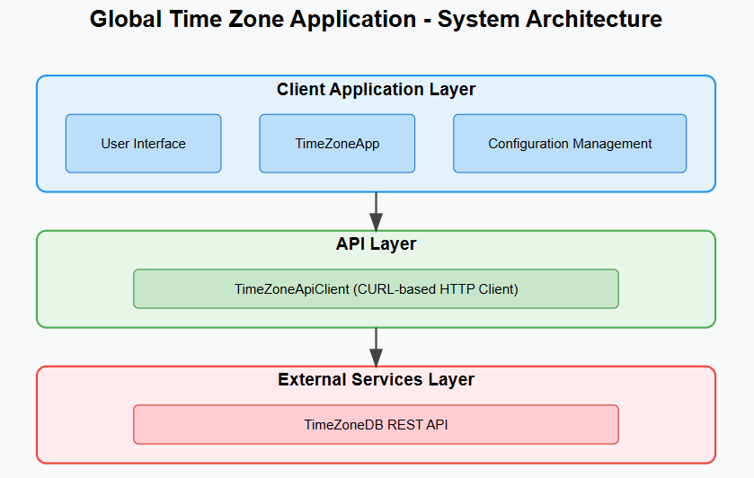
FLOWCHART
SYSTEM ARCHITECTURE

Slide 6
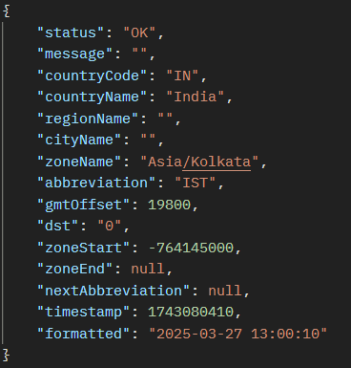
UNIQUE FEATURES
Real-Time Data
Independent of system clock
Always accurate global time information
Time calculations handled server-side
TimeZoneDB API
Free tier supports 1 request/second
Comprehensive database of time zones
DST information included
Libraries and Tools
CURL: HTTP requests to REST API
nlohmann/json: C++ JSON parsing
CMake: Finding and Linking External Libs
GitHub: Collaboration and Code Review
Postman: API Testing

Slide 7
TECHNICAL CHALLENGES FACED
Rapid API requests
Thread Pausing to prevent it
Error handling and fallback mechanisms
LIMITATIONS AND FUTURE WORK
API request rate limits
GUI implementation
Caching of Time Zone & User data

Slide 8
ANY QUESTIONS ?

Slide 9
THANK YOU!!

